Slide 1
Time Series and Related Quantitative Modeling

Slide 2
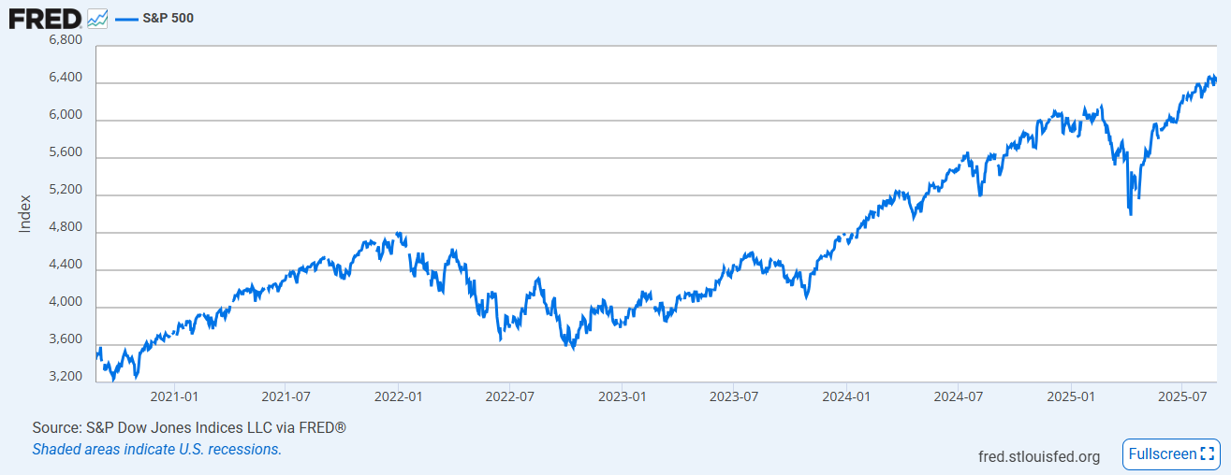
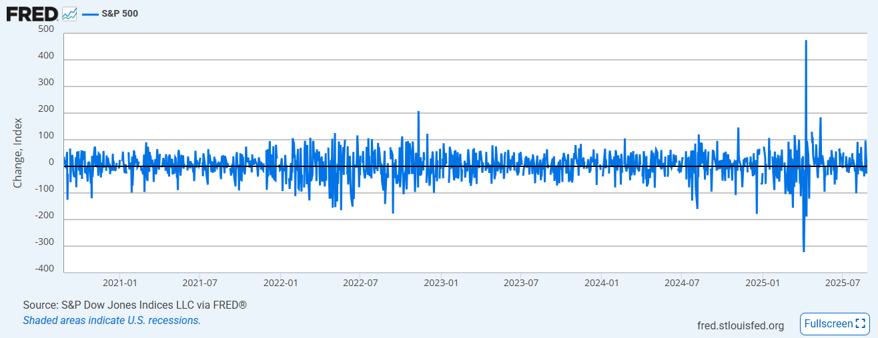
Overview
A time series in Financial markets is a sequence of observations of a financial variable(s) recorded at successive timepoints, e.g., daily, weekly, monthly. The financial variables could be the following
Equity prices
Interest rates
Credit spreads
Volatilities (e.g., VIX), …
Purpose of time series analysis
Modeling and forecasting (e.g., CCAR)
Trend and/or pattern identification (e.g., seasonality)
Scenario analysis, risk measurement (e.g., VaR), and more
Examples (S&P 500 index vs change*)
*: S&P 500 (SP500) | FRED | St. Louis Fed

Slide 3
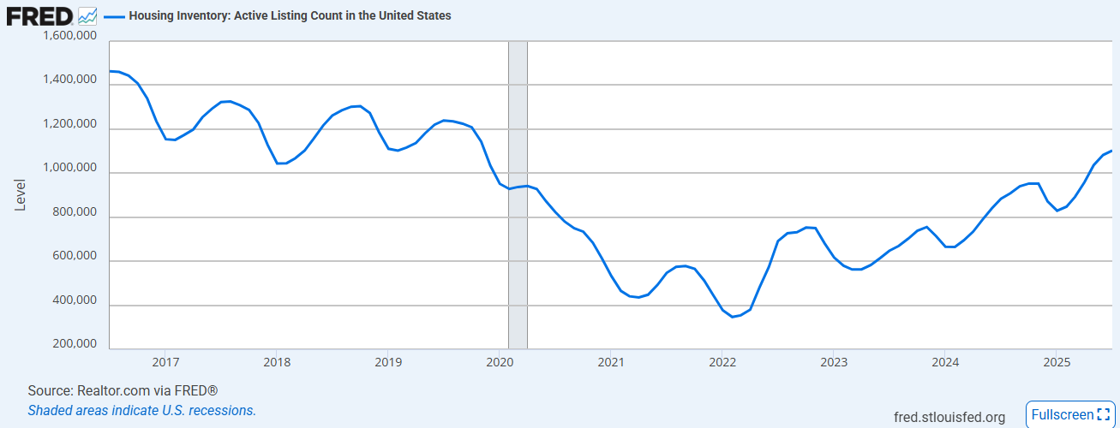
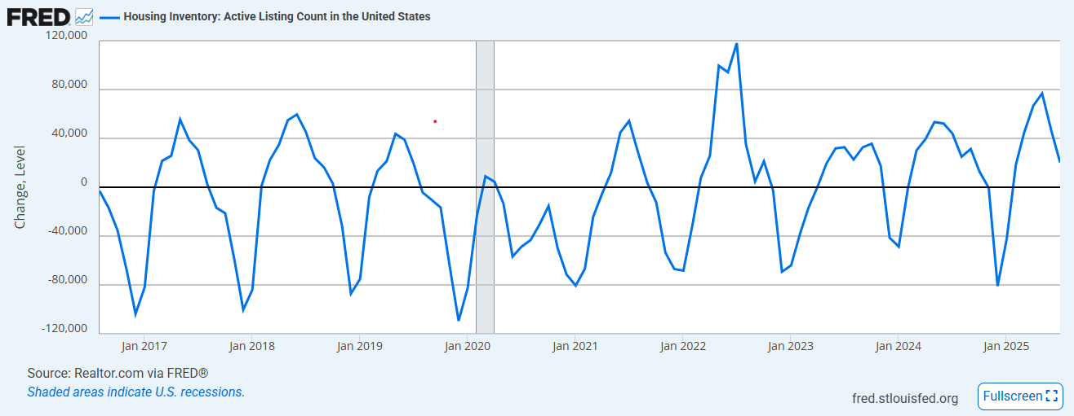
Overview (cont’)
Key components of a time series
Trend: long-term direction or movement
Example: upward trend in the S&P 500
Seasonality: regular, predictable pattern that repeats over a fixed period
Example: peak in summer and low in winter for housing inventory*
Cyclical component: longer term, non-fixed freq fluctuations
Example: economic cycle
Noise: white noise – independently and identically distributed (iid) normal random numbers
Other events driven irregularities
*: Housing Inventory: Active Listing Count in the United States (ACTLISCOUUS) | FRED | St. Louis Fed

Slide 4
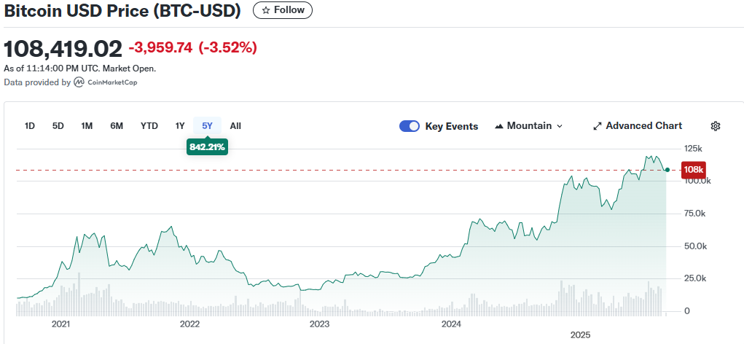
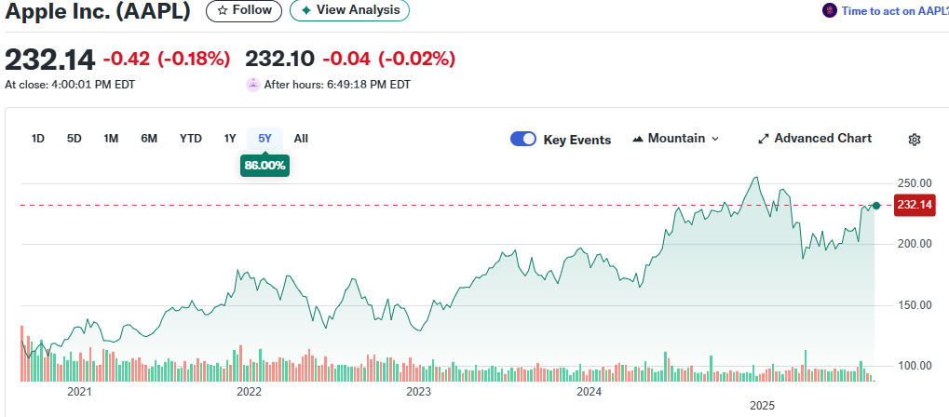

Stationarity
What is stationarity
Strict: all joint distributions are time-invariant
Weak: constant mean, variance and auto-covariance, i.e., only the first two moments are time- invariant
$$E\left[X_{t}\right] and VaR\left[X_{t}\right], are constant; Cov\left(X_{t}, X_{t+h}\right) depends on lag h only$$
Note: Strict stationarity → Weak stationarity
Why it matters
Upward trend leads to invalid relationship!
Unreliable statistical inference
Spurious regression
Stability of risk measure (e.g., VaR assumes each risk factor time series is stationary)

Slide 5
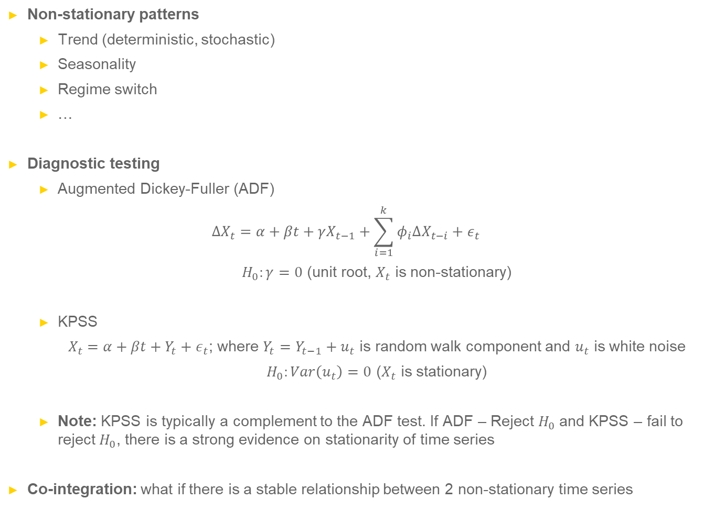
Stationarity (cont’)
Non-stationary patterns
Trend (deterministic, stochastic)
Seasonality
Regime switch
…
Diagnostic testing
Augmented Dickey-Fuller (ADF)
$$ΔX_{t}=α+βt+γX_{t−1}+\sum_{i=1}^{k}{φ_{i}ΔX_{t−i}}+ε_{t}$$
$H_{0}:γ=0$ (unit root, $X_{t}$ is non-stationary)
KPSS
$X_{t}=α+βt+Y_{t}+ε_{t}$; where $Y_{t}=Y_{t−1}+u_{t}$ is random walk component and $u_{t}$ is white noise
$H_{0}:Var\left(u_{t}\right)=0$ ($X_{t}$ is stationary)
Note: KPSS is typically a complement to the ADF test. If ADF – Reject $H_{0}$and KPSS – fail to reject $H_{0}$, there is a strong evidence on stationarity of time series
Co-integration: what if there is a stable relationship between 2 non-stationary time series

Slide 6

Stationarity (cont’)
Transformations to make a time series as stationary
Remove trend
Difference: $ΔX_{t}=X_{t}−X_{t−1}$
Change: $Y_{t}=\frac{X_{t}−X_{t−1}}{X_{t−1}}$
Remove seasonality
$$Y_{t}=X_{t}−X_{t−m}$$
Handle non-constant variance
$$Y_{t}=\log\left(X_{t}\right)$$
Note: always retest transformed time series with ADF/KPSS tests to confirm stationarity has been achieved
Application in Value-at-Risk (VaR)
Equity price: relative return
Interest rate: absolute change

Slide 7
Seasonality
What is seasonality
Time series experiences a predictable and periodic pattern
Predictable: the pattern (e.g., mean) repeats in a consist manner
Periodic: the time between the repetitions of the pattern, e.g.*,
Note: periodic != cycles (fluctuations w/o a fixed know period)
Examples:
House prices
Gas prices
Retail
Why it matters – refer to “Stationarity”
*: Housing Inventory: Active Listing Count in the United States (ACTLISCOUUS) | FRED | St. Louis Fed

Slide 8
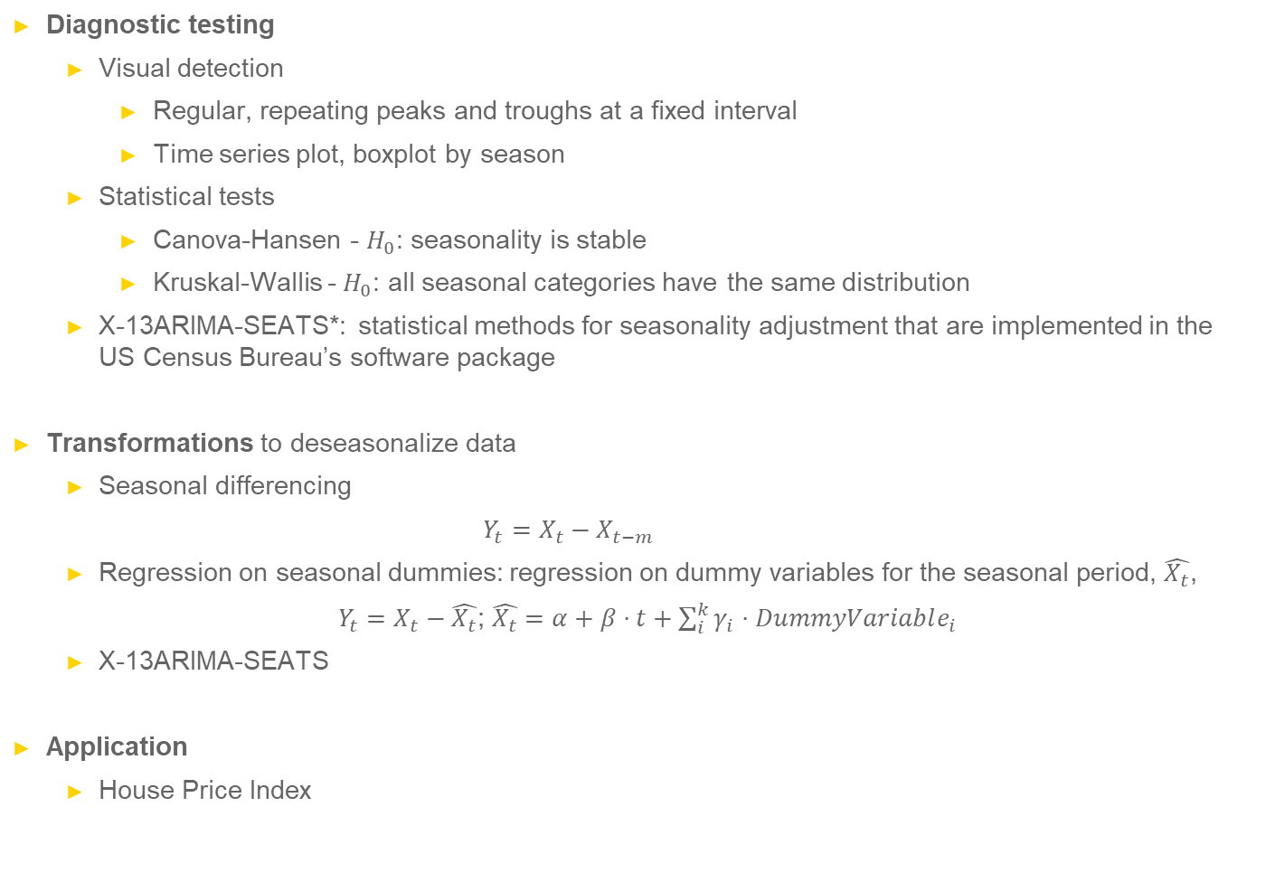
Seasonality (cont’)
Diagnostic testing
Visual detection
Regular, repeating peaks and troughs at a fixed interval
Time series plot, boxplot by season
Statistical tests
Canova-Hansen - $H_{0}$: seasonality is stable
Kruskal-Wallis - $H_{0}$: all seasonal categories have the same distribution
X-13ARIMA-SEATS*: statistical methods for seasonality adjustment that are implemented in the US Census Bureau’s software package
Transformations to deseasonalize data
Seasonal differencing
$$Y_{t}=X_{t}−X_{t−m}$$
Regression on seasonal dummies: regression on dummy variables for the seasonal period, $\hat{X_{t}}$,
$Y_{t}=X_{t}−\hat{X_{t}}$; $\hat{X_{t}}=α+β⋅t+\sum_{i}^{k}{γ_{i}⋅DummyVariable_{i}}$
X-13ARIMA-SEATS
Application
House Price Index
*:X-13ARIMA-SEATS Seasonal Adjustment Program

Slide 9
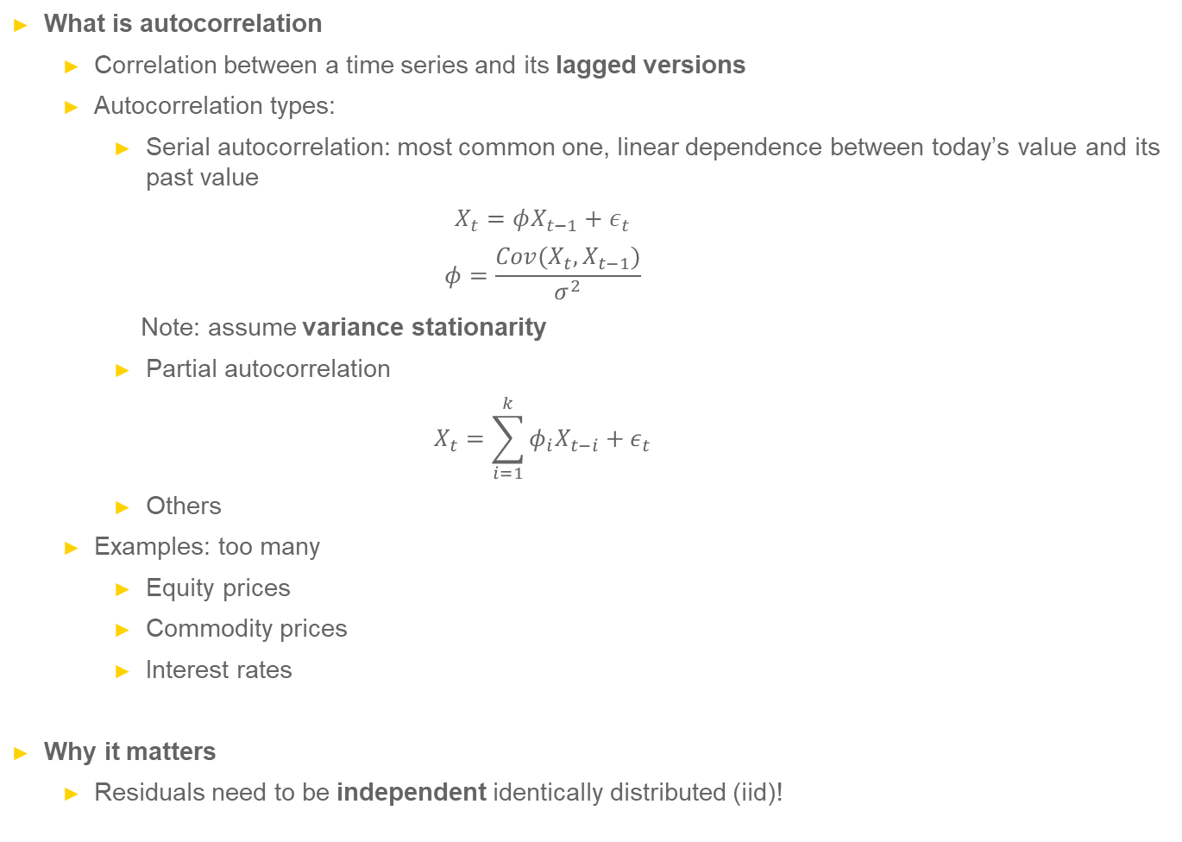
Autocorrelation
What is autocorrelation
Correlation between a time series and its lagged versions
Autocorrelation types:
Serial autocorrelation: most common one, linear dependence between today’s value and its past value
$$X_{t}=φX_{t−1}+ε_{t}$$
$$φ=\frac{Cov(X_{t},X_{t−1})}{σ^{2}}$$
Note: assume variance stationarity
Partial autocorrelation
$$X_{t}=\sum_{i=1}^{k}{φ_{i}X_{t−i}}+ε_{t}$$
Others
Examples: too many
Equity prices
Commodity prices
Interest rates
Why it matters
Residuals need to be independent identically distributed (iid)!

Slide 10
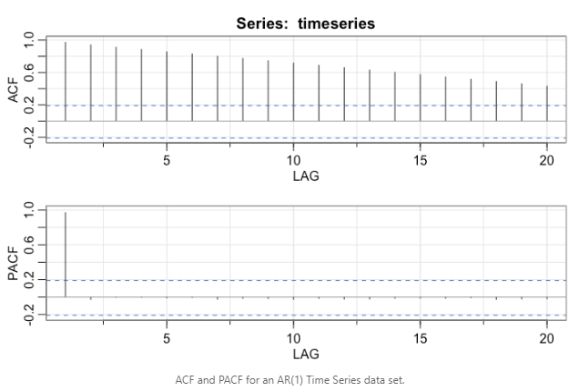
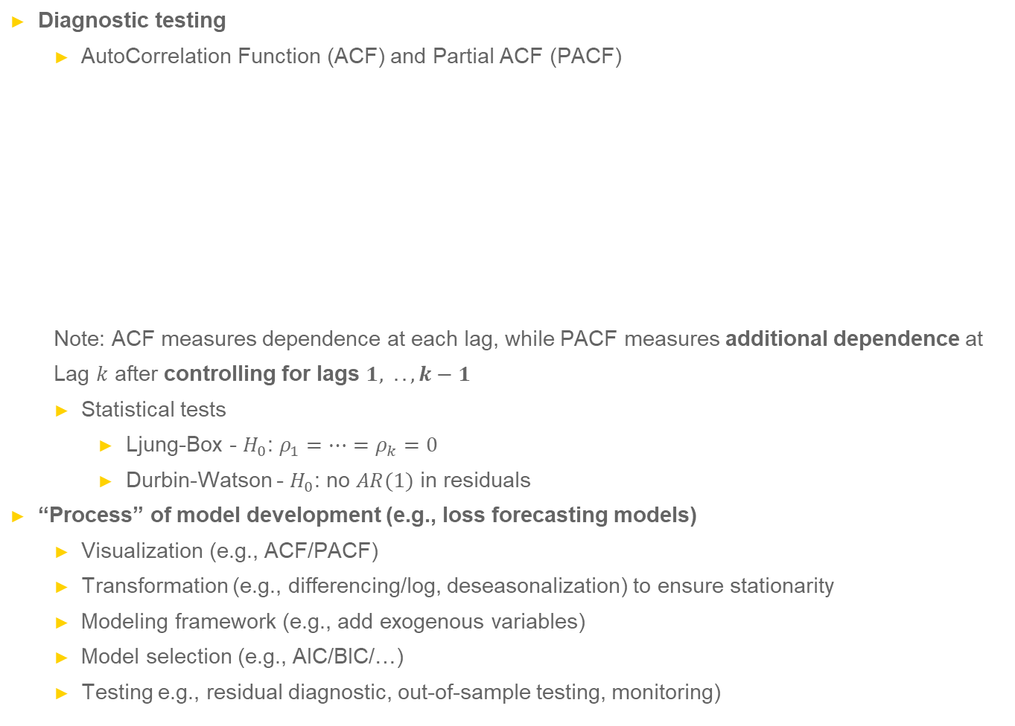
Autocorrelation (cont’)
Diagnostic testing
AutoCorrelation Function (ACF) and Partial ACF (PACF)
Note: ACF measures dependence at each lag, while PACF measures additional dependence at
Lag $k$ after controlling for lags $1, .., k−1$
Statistical tests
Ljung-Box - $H_{0}$: $ρ_{1}=…=ρ_{k}=0$
Durbin-Watson - $H_{0}$: no $AR(1)$ in residuals
“Process” of model development (e.g., loss forecasting models)
Visualization (e.g., ACF/PACF)
Transformation (e.g., differencing/log, deseasonalization) to ensure stationarity
Modeling framework (e.g., add exogenous variables)
Model selection (e.g., AIC/BIC/…)
Testing e.g., residual diagnostic, out-of-sample testing, monitoring)

